Slide 1
DATA 468: Applied Stochastic Process
by
Dr. Zakir
Department of Mathematics University of Arizona
Email: zakir@arizona.edu

Slide 2
Outline
State Probability Distributions
Single step Transition Probabilities
n-Step Transition Probabilities
Supplementary reading
3
4
Notes:
https://www.probabilitycourse.com/chapter11/11_2_3_probability_distributions.php

Slide 3
State Probability Distributions
A Markov chain can have either a definite or a random initial state.
The initial state determines the starting point of the sequence of transitions.
P(X₀=i)=π⁽⁰⁾=π: The initial distribution (probability vector) over states at time n=0.
Knowing X₀, how we can obtain the probability distributions for X₁, X₂, . . .?
Notes:
https://www.stat.auckland.ac.nz/~fewster/325/notes/ch1annotated.pdf

Slide 4
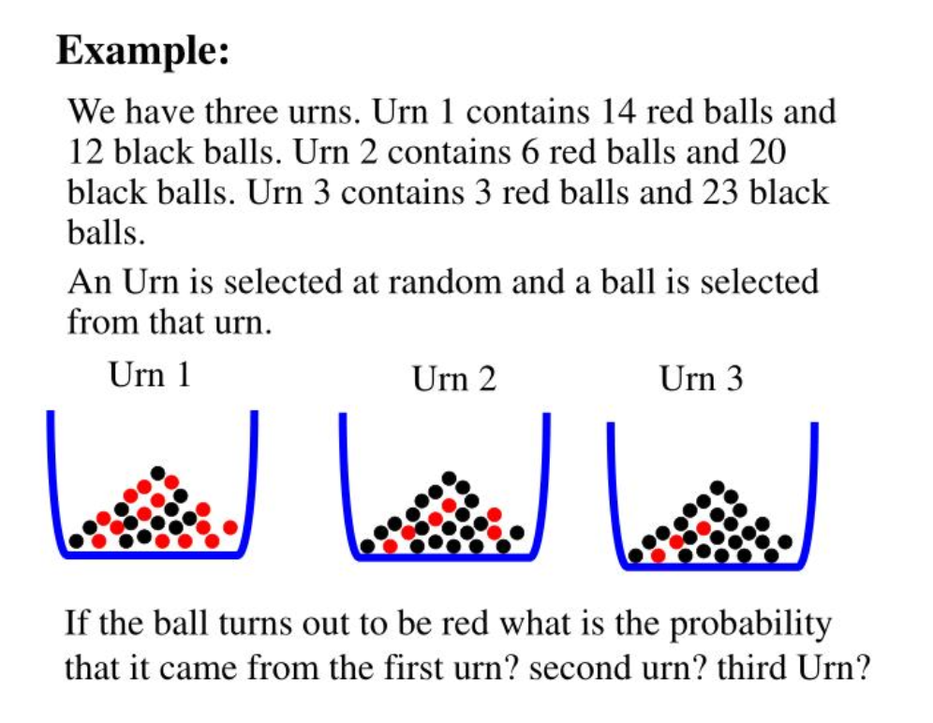
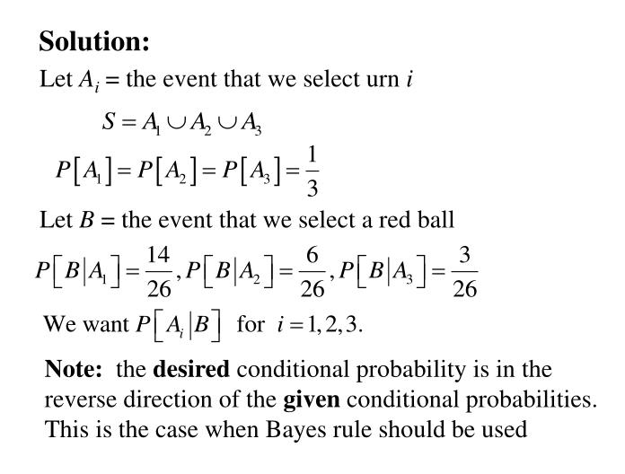
The law of total probability

Slide 5
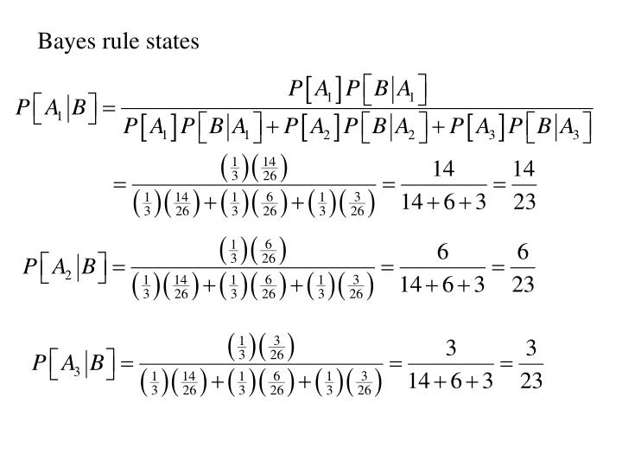
Bayes Rule

Slide 6
State Probability Distributions
The Law of Total Probability helps you calculate the probability of an event by considering all the possible ways it can happen through a partition of the sample space.
If an event can occur in several ways, the total probability of the event is the sum of the probabilities of the different ways in which it can occur.
According to the partition theory and law of total probability
p_{ij} is the probability of making a transition from state i to state j in a single step.
Notes:
https://www.stat.auckland.ac.nz/~fewster/325/notes/ch1annotated.pdf
Summation and matrix: https://linearalgebra.math.umanitoba.ca/math1220/section-52.html

Slide 7
State Probability Distributions
Similarly for two steps
More generally the probability distribution over all possible states of a Markov chain at time n is:
Notes:
https://www.stat.auckland.ac.nz/~fewster/325/notes/ch1annotated.pdf
Law of total probability : https://www.probabilitycourse.com/chapter1/1_4_2_total_probability.php
Very nice: https://www.stat.auckland.ac.nz/~fewster/325/notes/ch8.pdf

Slide 8
The two-step transition probabilities
In order to get to state j from i in two steps we need to pass through some intermediate state k.
The probability of this event is p_{ik}p_{kj}. To obtain , we sum over all possible intermediate states.
Notes:
https://www.stat.auckland.ac.nz/~fewster/325/notes/ch1annotated.pdf
https://youtu.be/VAwgGak-yOw?si=G1SOmC2AwNo8DQwn
conditional Probability: https://ctools.ece.utah.edu/Probability/ConditionalProb/DiscreteRandVars/ProbCondDiscreteDefs.pdf

Slide 9
The two-step transition probabilities: Example
Probability of reaching from state 2 to sate 0 in exactly 2-steps

Slide 10
The n-step transition probabilities
More generally, we can define the n-step transition probabilities as
P^{(n)}: Transition matrix at time t=n. P^{n}: n power raised to the transition matrix. P^{(n)}=P^{n} (induction)
Notes:
https://www.stat.auckland.ac.nz/~fewster/325/notes/ch1annotated.pdf
https://youtu.be/VAwgGak-yOw?si=G1SOmC2AwNo8DQwn
conditional Probability: https://ctools.ece.utah.edu/Probability/ConditionalProb/DiscreteRandVars/ProbCondDiscreteDefs.pdf

Slide 11
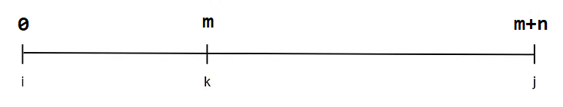
Chapman Kolmogrov equation
Let m and n be two positive integers and assume X₀=i.
In order to get to state j in (m+n) steps, the chain will be at some intermediate state k after m steps.
To obtain , we sum over all possible intermediate states:
It can be used to calculate n-steps transition from a single step transaction matrix
Notes:
https://youtu.be/W5P4kCpdhho?si=MfNSkS4bGGobefPo

Slide 12
Chapman Kolmogrov equation
Think of going from i to j in m+n steps, with intermediate sate k after m steps
Example: i=0, j=2, m+n=2, m=1

Slide 13
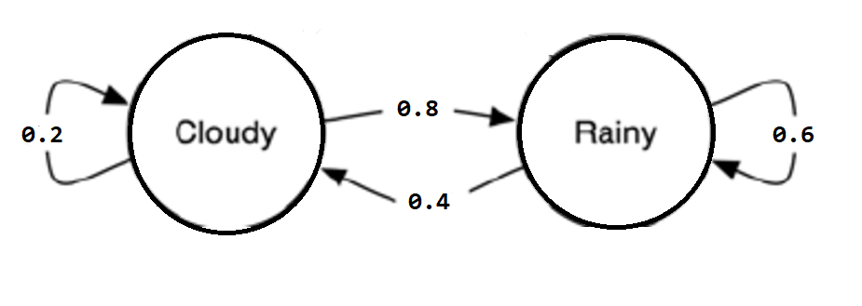
Sate probability distribution: Example
Consider a system that can be in one of two possible states, S={1,2}={Cloudy, Rainy}.
Suppose that the system is in state 1 at time n=0, i.e., X₀=1.
Find the probability that the system is in state 2 at time n=3.
Notes:
https://www.stat.auckland.ac.nz/~fewster/325/notes/ch1annotated.pdf
Real exp: https://www.ma.imperial.ac.uk/~ejm/M3S4/NOTES3.pdf

Slide 14
Supplementary reading
Uses of Markov Chains
Weather prediction
Text generation (e.g., Markov models in NLP)
Economics & finance
Game theory
Queuing systems
Notes:
https://www.stat.auckland.ac.nz/~fewster/325/notes/ch1annotated.pdf

Slide 15
Supplementary reading
Definitions:
Transition Probabilities (Matrix P): This is a matrix where each entry P_{ij}​ gives the probability of transitioning from state i to state j in one step.
State Distribution Probabilities (Vector π^{(t)}): This is a row vector that gives the probability of being in each state at time t. For example,
where
Notes:
https://www.stat.auckland.ac.nz/~fewster/325/notes/ch1annotated.pdf

Slide 16
Supplementary reading
A row of a matrix can be written in summation notation because it's essentially a linear combination of the standard basis vectors of the row space, or just a way to express the entries of the row in a compact mathematical form.
Notes:
https://www.stat.auckland.ac.nz/~fewster/325/notes/ch1annotated.pdf

Slide 17
Supplementary reading
X_{0​} is the state of the process at time 0.
P(X₀=j) is the probability that the process starts in state j.
π⁽⁰⁾ denotes the initial distribution of the Markov chain — specifically, the probability distribution over all states at time 0.
π=[π₁, π₂,…, π_{n}]: the initial distribution (i.e., π_{i}=P(X₀=i) — a row vector.
P=[P_{ij}]: the transition matrix, where P_{ij}=P(X₁=j ∣ X₀=i).
This is just a dot product of the initial distribution π and the j-th column of the transition matrix P.
for all j∈{1,…, n}.
Notes:
https://www.stat.auckland.ac.nz/~fewster/325/notes/ch1annotated.pdf

Slide 18
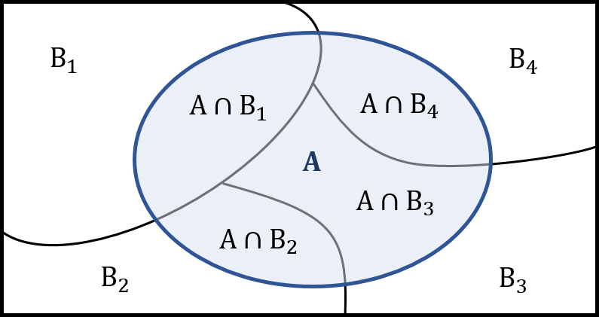
Supplementary reading
Law of Total Probability:
If B₁, B₂, B₃,⋯ is a partition of the sample space S, then for any event A we have
Notes:
https://www.stat.auckland.ac.nz/~fewster/325/notes/ch1annotated.pdf

Slide 19
Supplementary reading
Conditional probability
In probability theory, conditional probability is a measure of the probability of an event occurring, given that another event (by assumption, presumption, assertion or evidence) is already known to have occurred
Event A occurring with some sort of relationship with another event B.
In this situation, the event A can be analyzed by a conditional probability with respect to B.
If the event of interest is A and the event B is known or assumed to have occurred, "the conditional probability of A given B", or "the probability of A under the condition B", is usually written as P(A|B)
Notes:
https://www.stat.auckland.ac.nz/~fewster/325/notes/ch1annotated.pdf

Slide 20
Supplementary reading
The law of total probability
S
Notes:
https://radzion.com/blog/probability/total
https://youtu.be/F3y8qupFfUs?si=SkxiaUHEB9rEhAS9
https://www.handsonsystem.com/blog.php?slug=probability-theory

Slide 21
Supplementary reading
Partition theory:
In the context of a sample space, partition theory refers to dividing a sample space into mutually exclusive and collectively exhaustive subsets.
Partitions are fundamental in probability for calculating probabilities of events using the Law of Total Probability.
Partition 1: {1, 2, 3} (odd numbers) and {4, 5, 6} (even numbers)
Partition 2: {1, 2}, {3, 4}, {5, 6}
Both of these are valid partitions because they are mutually exclusive (the subsets don't share elements) and collectively exhaustive (they cover all the numbers 1 through 6).
Mutually exclusive: Intersection is empty set
Exhaustive: Union is the entire sample space

Slide 22
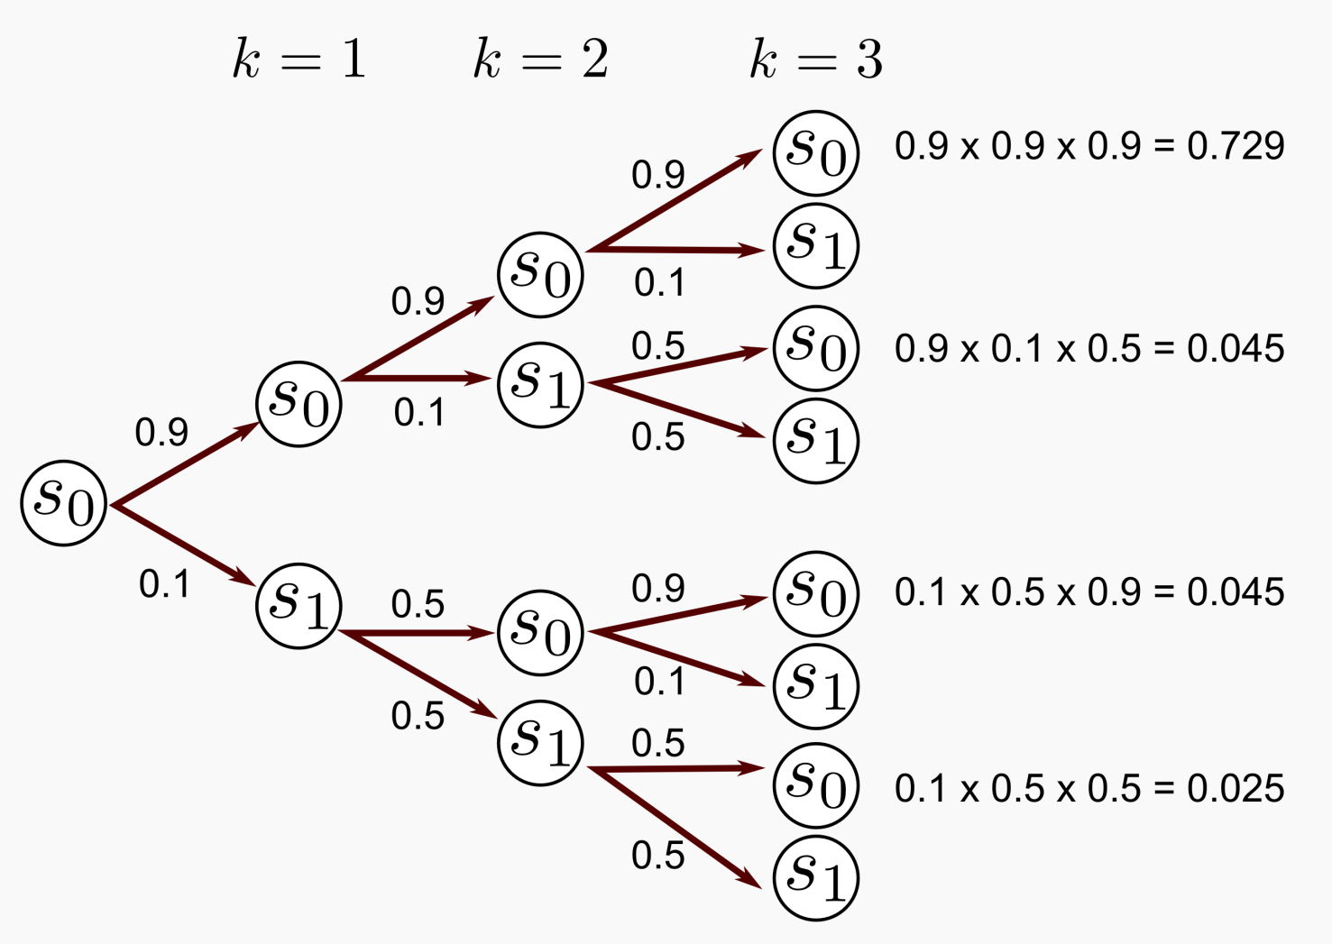
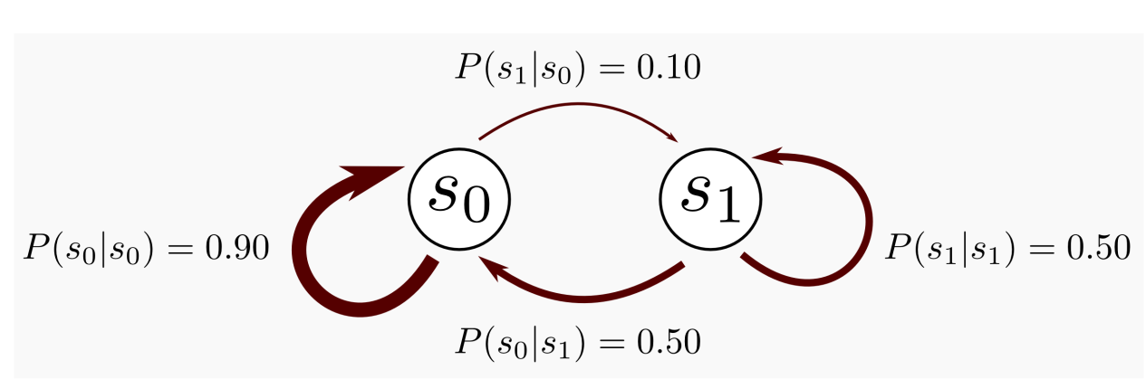
Supplementary reading
Notes:
https://mpatacchiola.github.io/blog/2016/12/09/dissecting-reinforcement-learning.html

Slide 23
Conditional Probability
P(X₂, X₁, X₀) = P(X₂ | X₁, X₀)= P(X₂ | X₁, X₀). P(X₁ | X₀)

